Slide 1



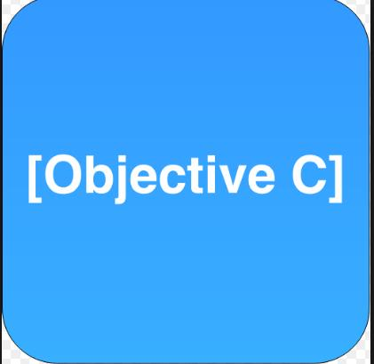
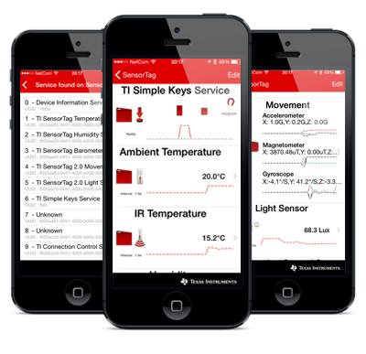
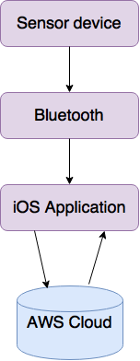
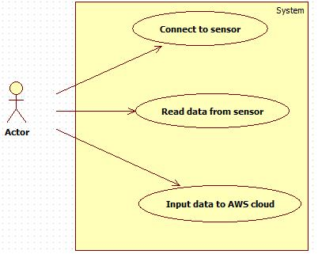
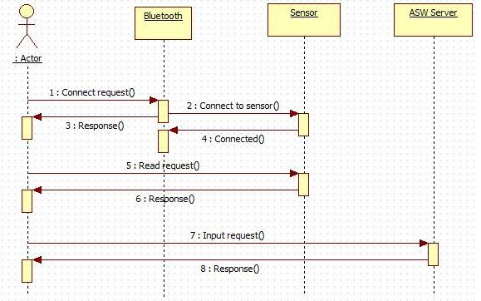
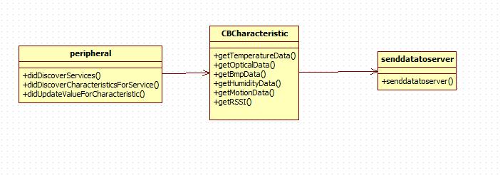
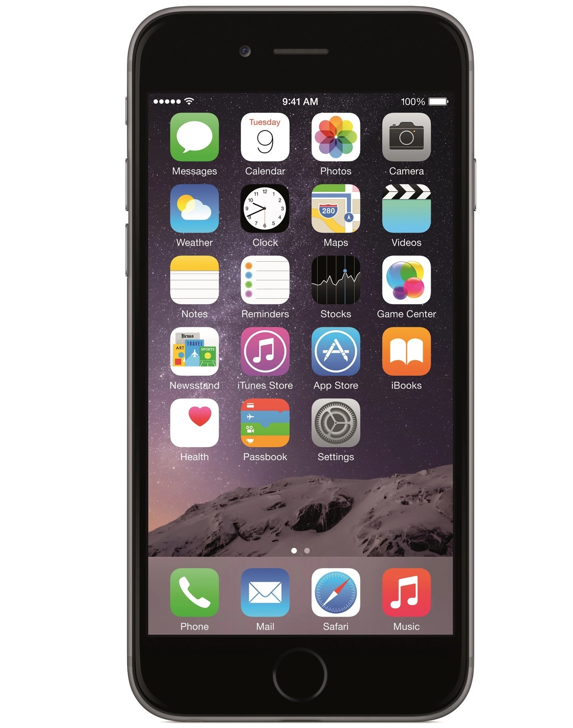
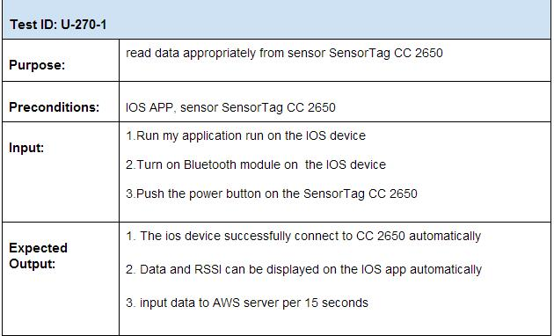
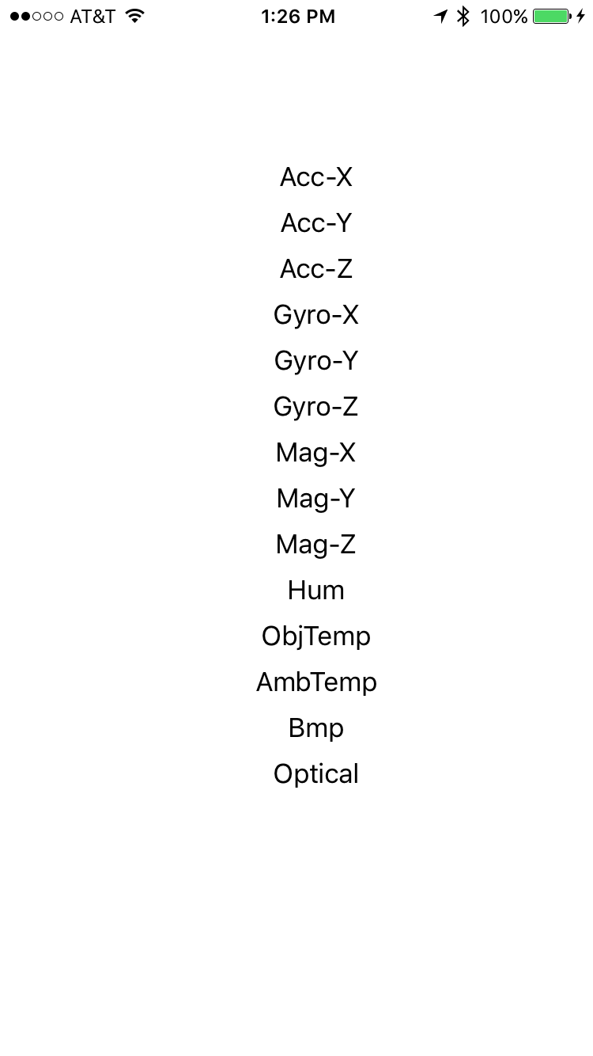
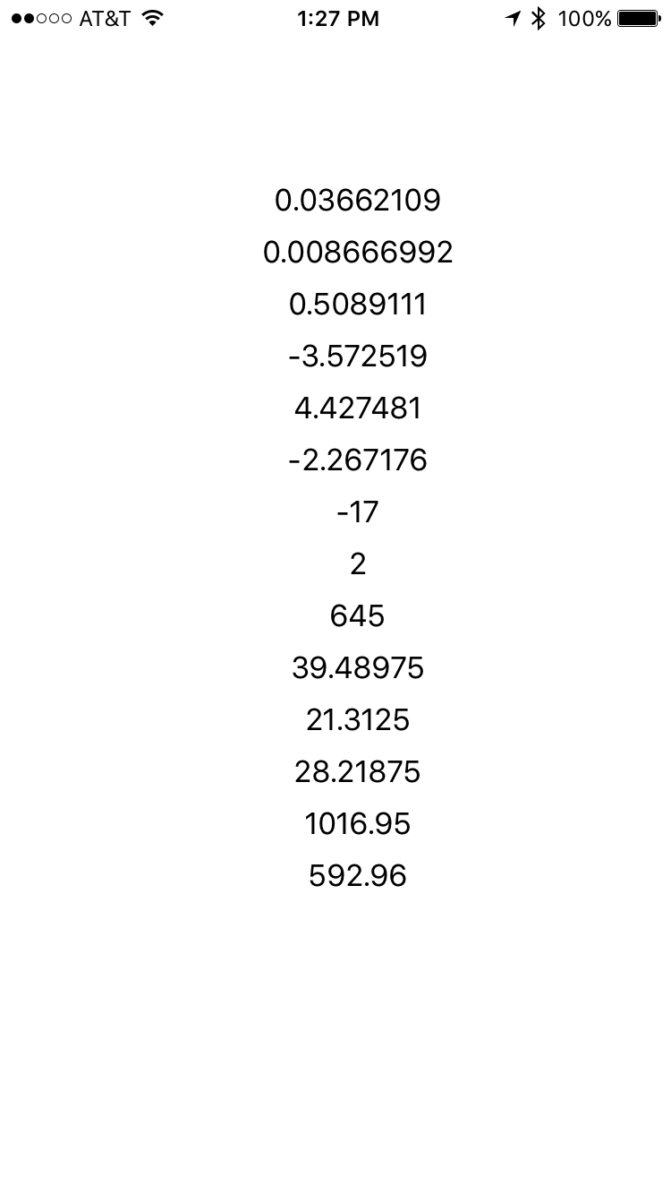
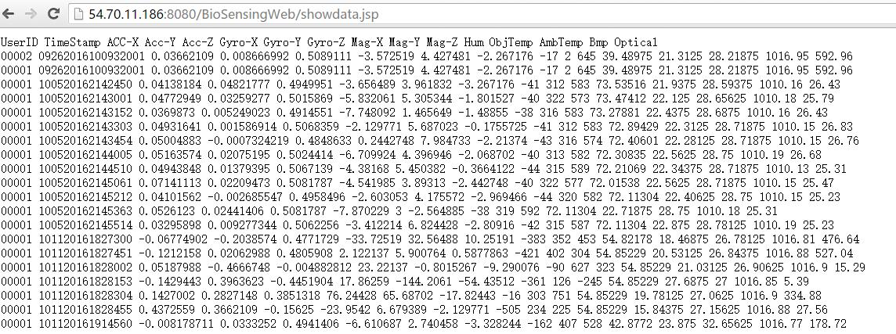
School of Computing & Information Sciences
Advanced Software Engineering, 2016, Fall
Biosensor 1.0
Student: Zhiyuan Shi, Florida International University
Mentor: Dr. Shekhar Bhansali, Florida International University
Mohsen Taheri, Florida International University
Instructor: Masoud Sadjadi, Florida International University
Problem
Current System
Requirements
Biosensing App is a system which combines biosensor device, mobile application and cloud service together to detect, calibrate and analyze individual patient’s different kind of analyte such as blood pressure, heart rate or alcohol level for clinical purpose
Currently, there is no such a system to fulfil the requirements. But there are distinct parts which could be used to build the system:
Biosensor with bluetooth module to detect the analyte and send the data
A manufacturer's mobile app to display the data collected from sensor tag
Functional/Non-functional features I focuse on:
The ios device can connect to the sensor
The ios device can read data from the sensor
The users can see data type on the home page
The users can see real-time data on the home page
The ios device can send data to AWS cloud databse per 15 seconds
Solution
1. Develop a mobile application that could connect to the sensor and read the data from sensor.
2. Input data into AWS cloud database
System Design
Object Design
Implementation
Layered Architecture
Used xcode for the development of iOS app
Used Object C for programming
Used iPhone device to test the application
Verification
Screenshots
Summary
Responsible for developing an iOS application
I read the data from sensor and converted into a proper format
A home page was created to show the real-time data and type from the sensors currently used. i-e heartrate and temperature
I input data that read from sensor into AWS cloud database per 15 seconds
Acknowledgement
The material presented in this poster is based upon the work supported by Dr. Shekar Bhansali. I am thankful to the help that I received from my group members, Xin Zhaoand Vishal-Chhatwani

